Slide 1
Hackathon Project
Group-2
Cohort-INTQEA21QE0(61,62,63)

Slide 2
Team Members
Ankit Karmakar - 934480
Ankit Behera - 935061
Akriti Nanda - 935060
Rishav Kumar - 935238
Arunangshu Banerjee - 934507

Slide 3
Problem Statement : Calculate Trip Cost
Display total amount and charges per night for 3 holiday homes:
1. For 4 people in Nairobi from 15th Dec-2019 to 20th Dec-2019
2. Sort the list with highest traveler rating on top.
3. Holiday home should have elevator/ List access.
(Suggested Site: tripadvisor.in however you are free to choose any other legitimate site)+B6

Slide 4
Detailed Description
1. Display Hotel name, total amount and charges per night for 3 holiday homes for 4 people in Nairobi for 5 days of stay from tomorrow's date; Should have sorted the list with highest traveler rating & should have elevator/ List access
2 Pick one cruise line & pick a respective cruise ship under Cruises;
a. Retrieve all the languages offered and store in a List; Display the same
b. Display passengers, crew & launched year
(Suggested Site: tripadvisor.in however you are free to choose any other legitimate site)

Slide 5
Website used:
https://www.tripadvisor.in/
Tools/Software's Used:
Selenium – Portable Framework for testing Web Applications and automating the process.
Java – High level Programming Language.
Eclipse – Integrated Development Environment for various ‘Languages’.
TestNG – Open source testing framework.
Maven – Software and project Management Tool.
POM – Object repository design pattern.
Jenkins – An open source automation server for continuous integration.
Selenium Grid – Tool use to distribute test to run test in parallel on multiple machine or browser.
GIT – A distributed version-control system for tracking changes in any set of files for better co-ordination.

Slide 6
Work Done
The code is written in JAVA language and then is further automated using Selenium.
Page Object Model(POM) is used to reduce the code duplication for various instances.
Data obtained from website is stored in Excel Sheet using Apache POI; also, data input is taken from a file with variables written in it.
Jenkins, Grid and GIT repositories are also used, so as to make it easy to make changes to various versions of code and to modularise it; also to help with continuous integration.

Slide 7
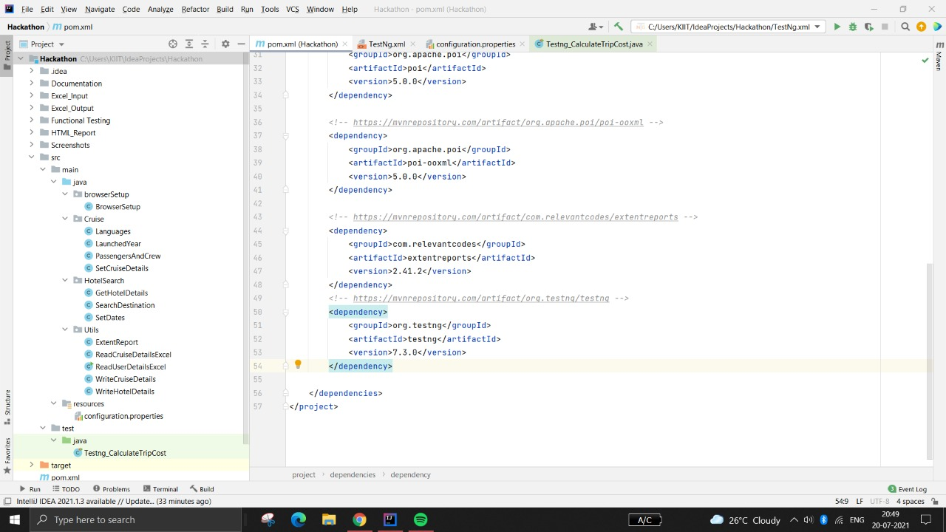
Project Structure

Slide 8
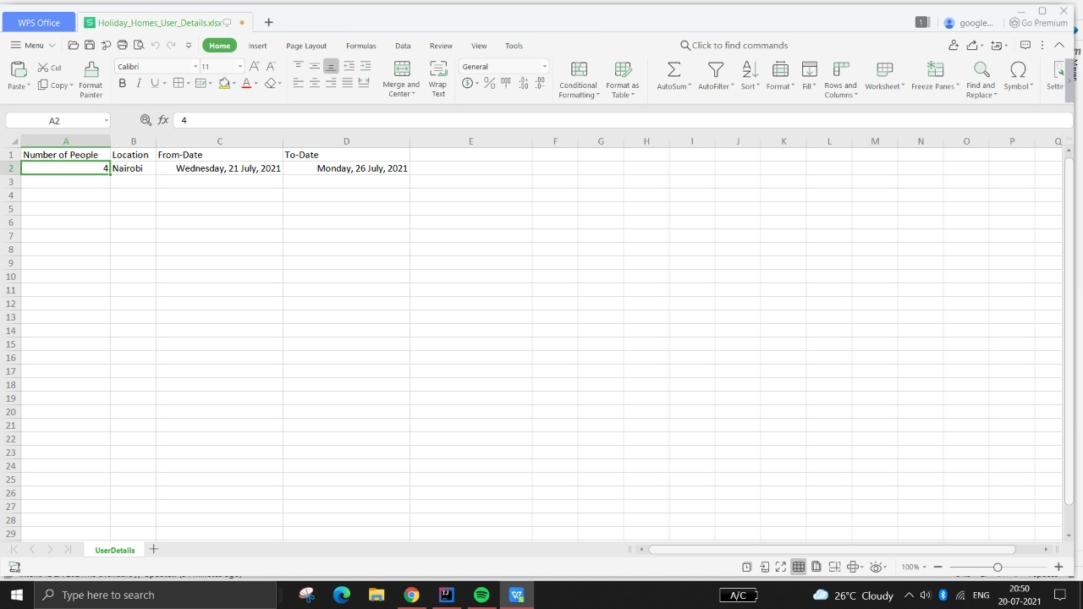
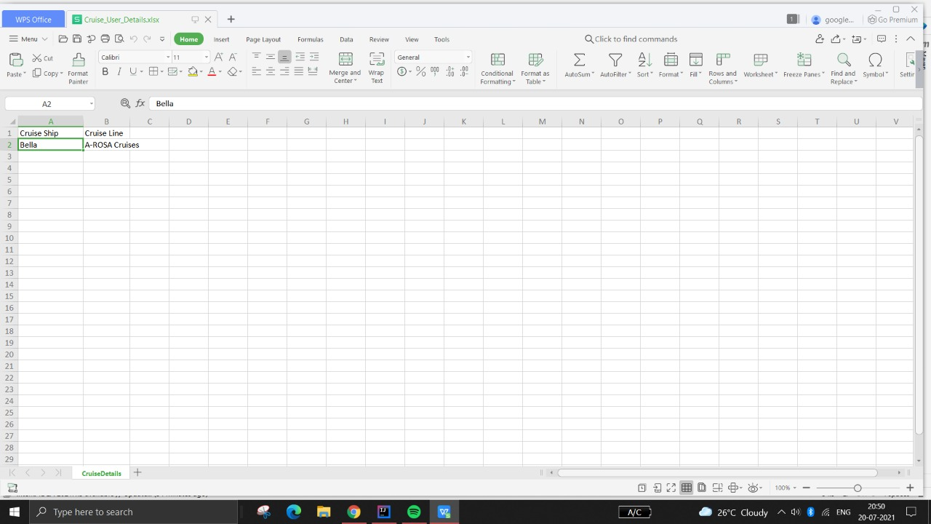
Input Excel File
Holiday Homes User Details
Cruise User Details

Slide 9
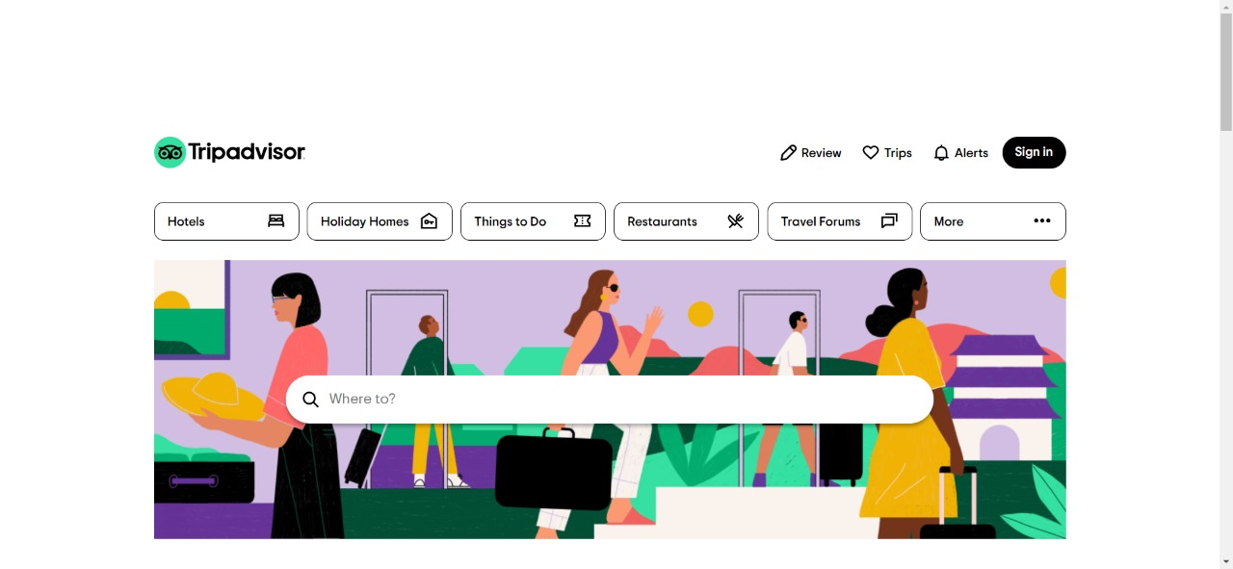
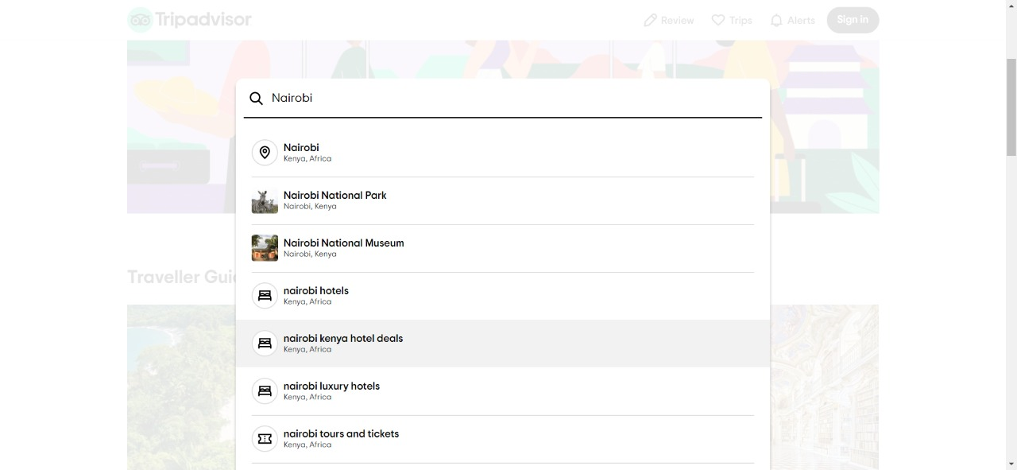
Real Time Screenshot
Tripadvisor Homepage
Drop Down to search “Nairobi”

Slide 10
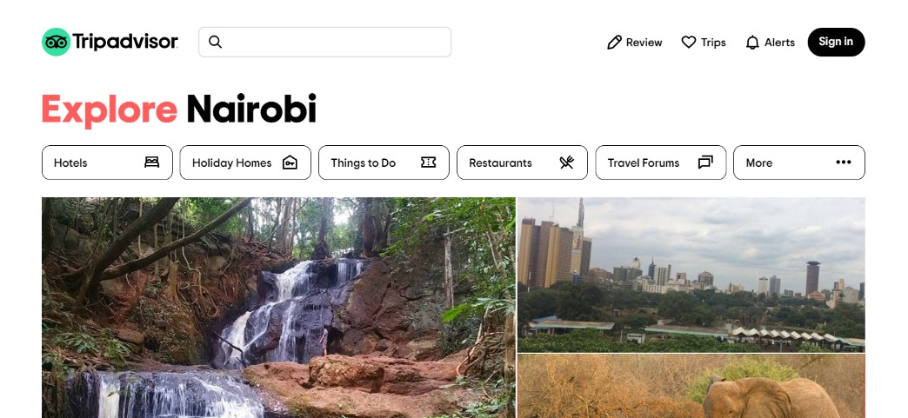
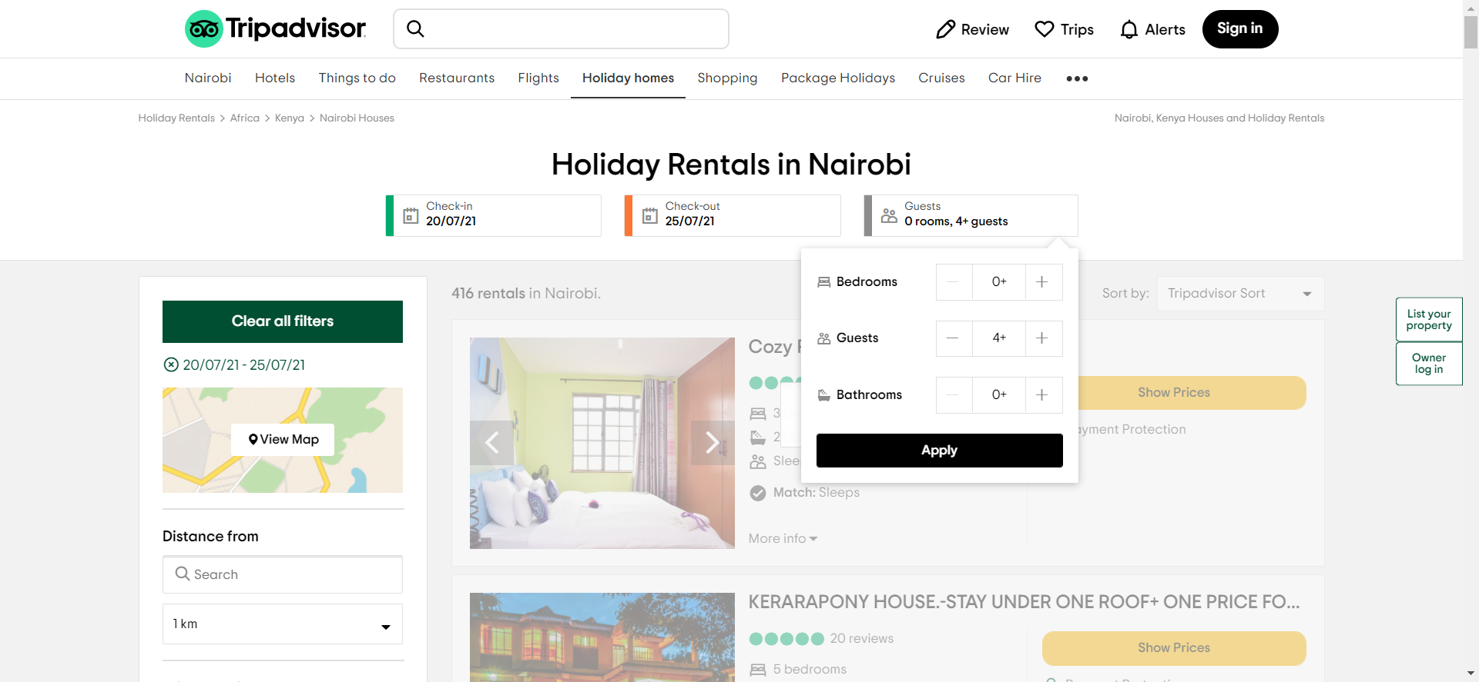
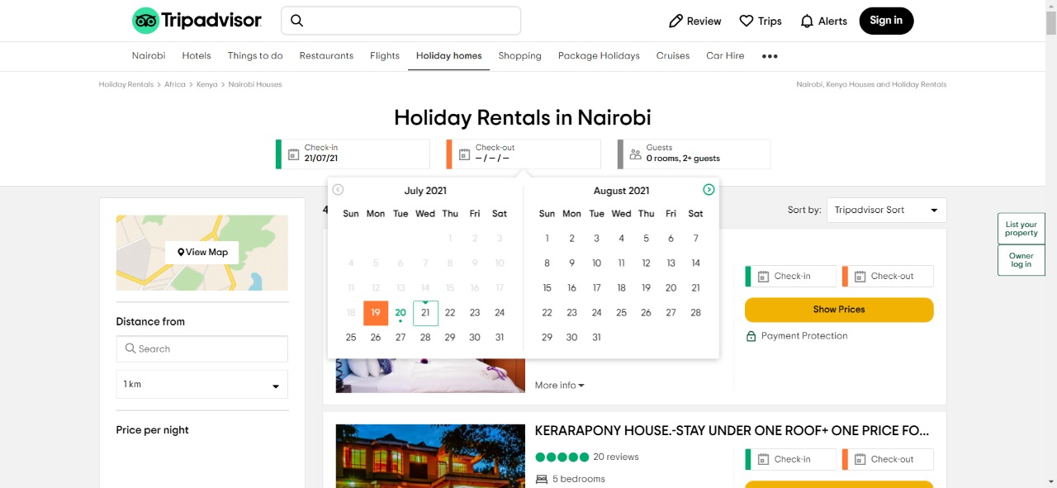
Real Time Screenshot
After clicking Nairobi, “Explore Nairobi” page appears
Entering Number of Guests
Entering Check-in & Check-out dates

Slide 11
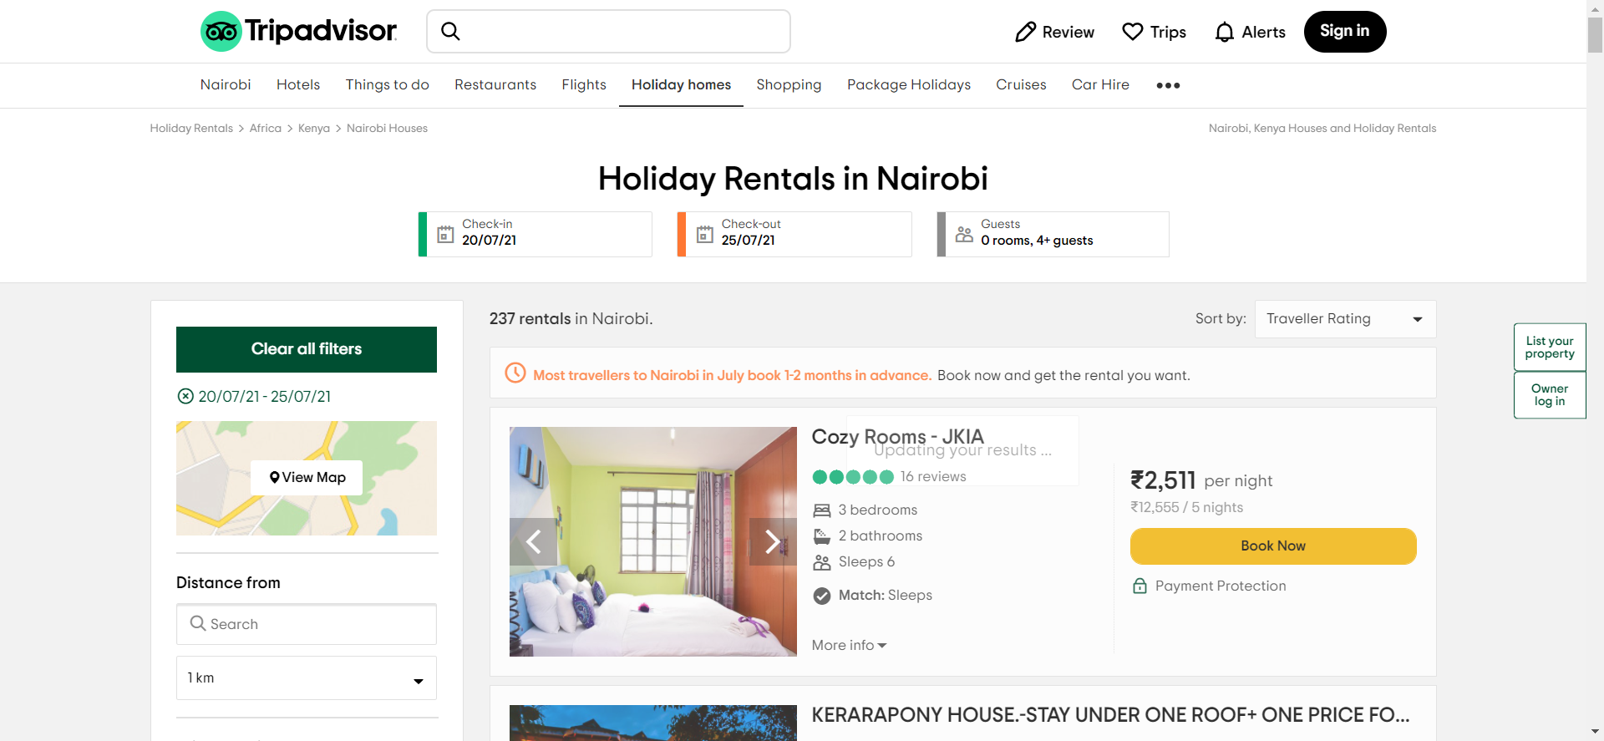
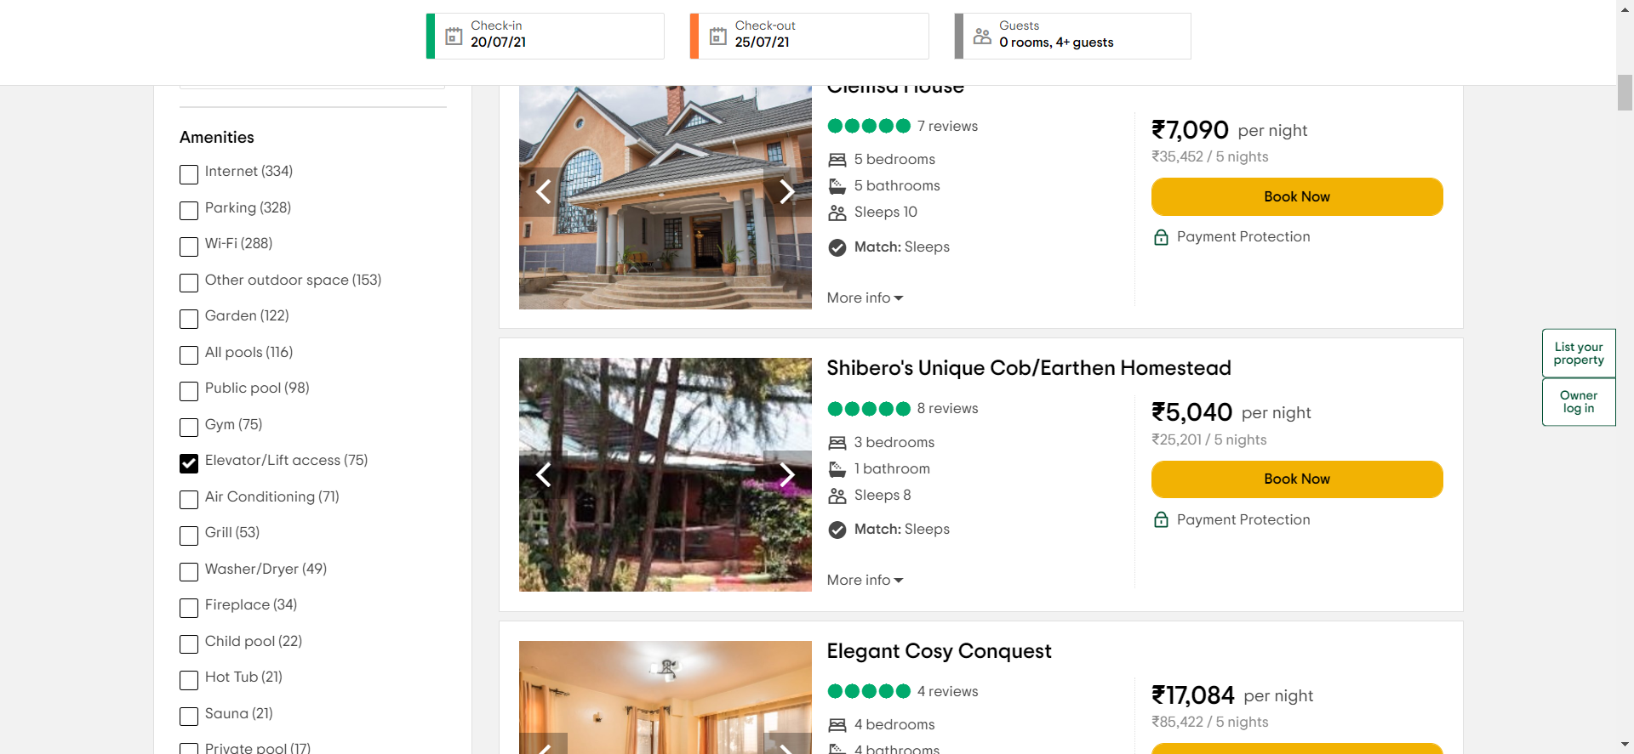
Real Time Screenshot
Sorting by “Traveller Ratings”
Selecting for Elevator/Lift Access in amenities drop down

Slide 12
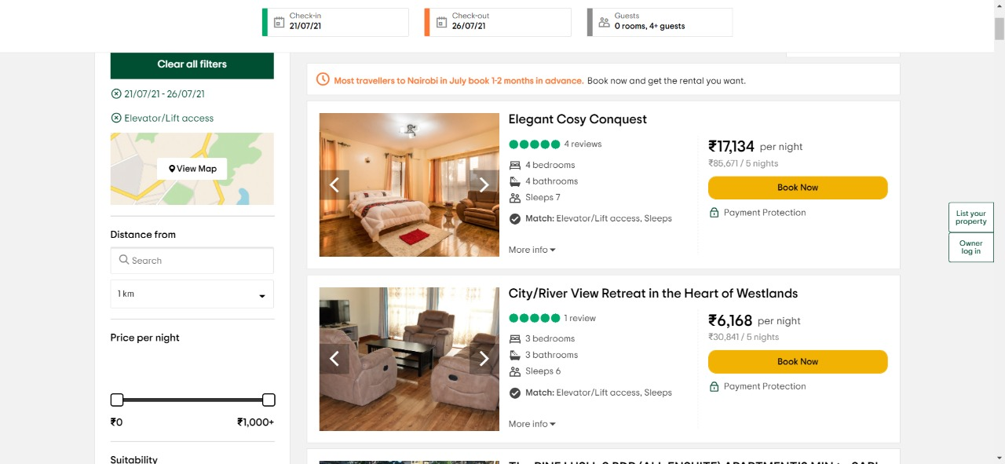
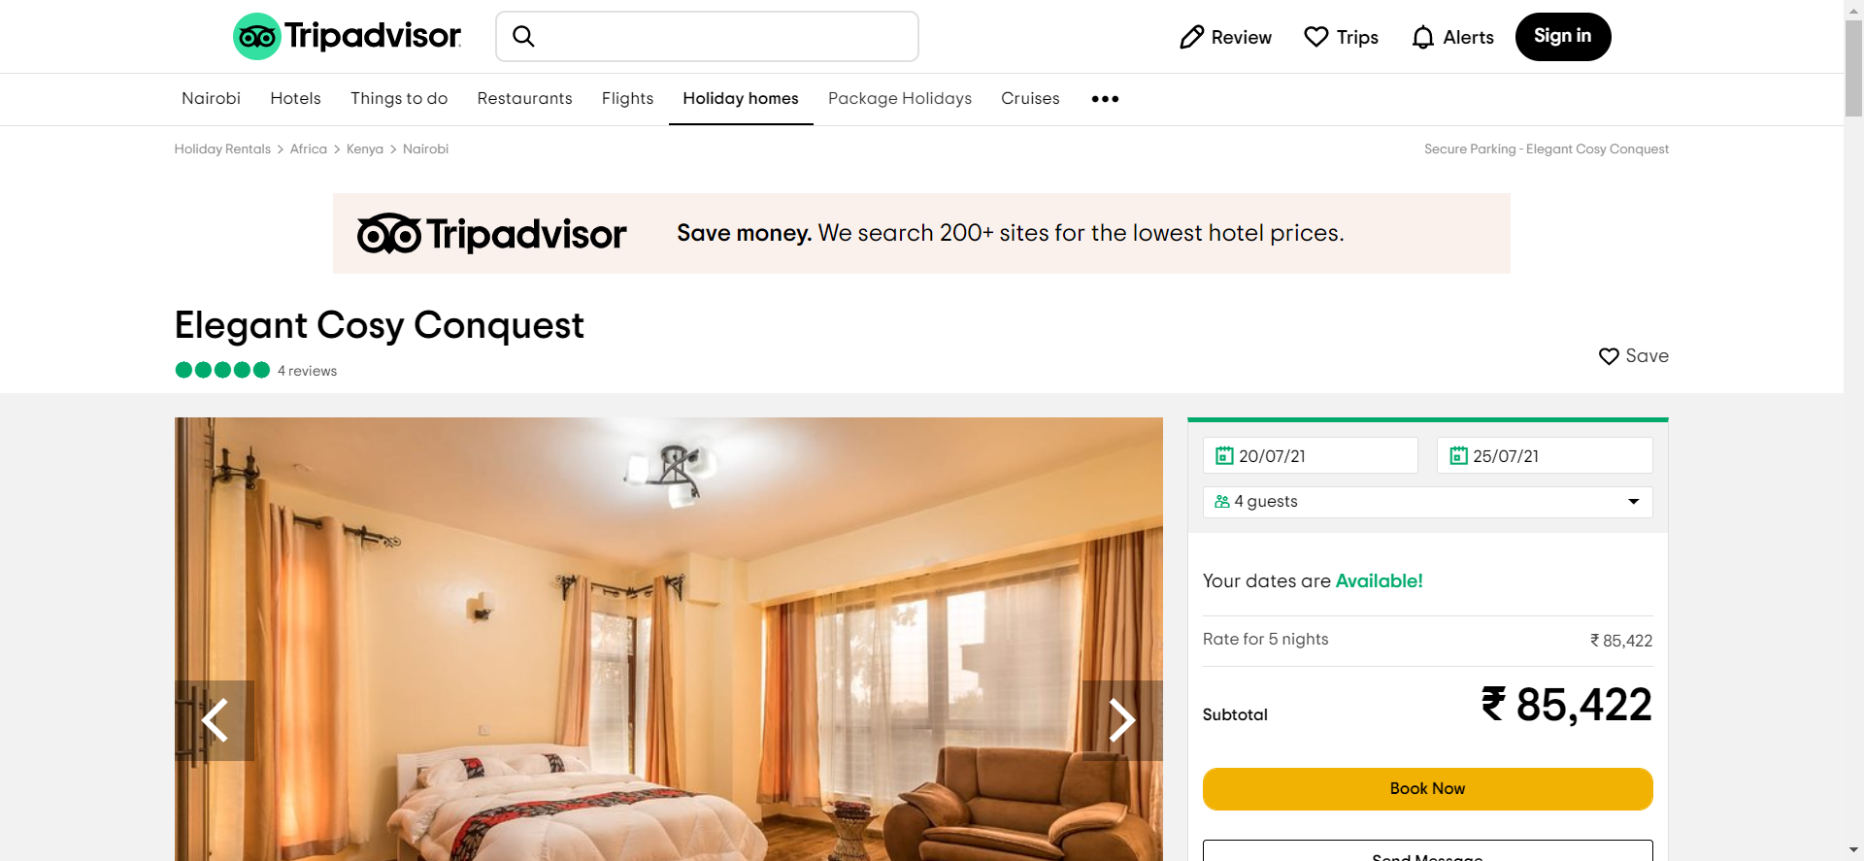
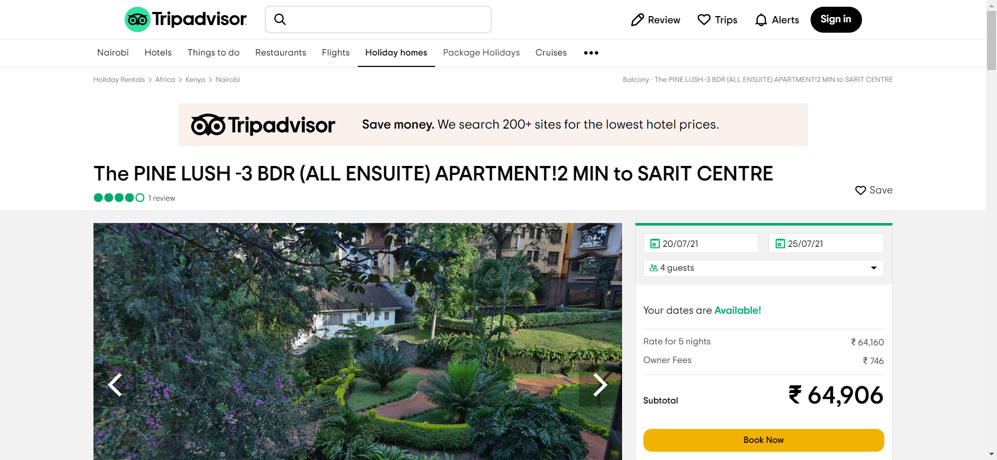
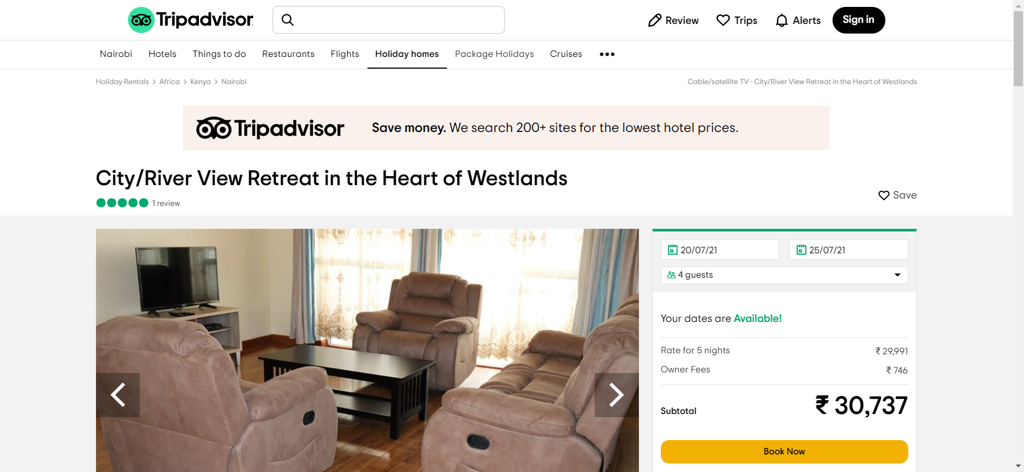
Real Time Screenshot
HOTEL SEARCH OPTIONS
HOTEL-1
HOTEL -2
HOTEL-3

Slide 13
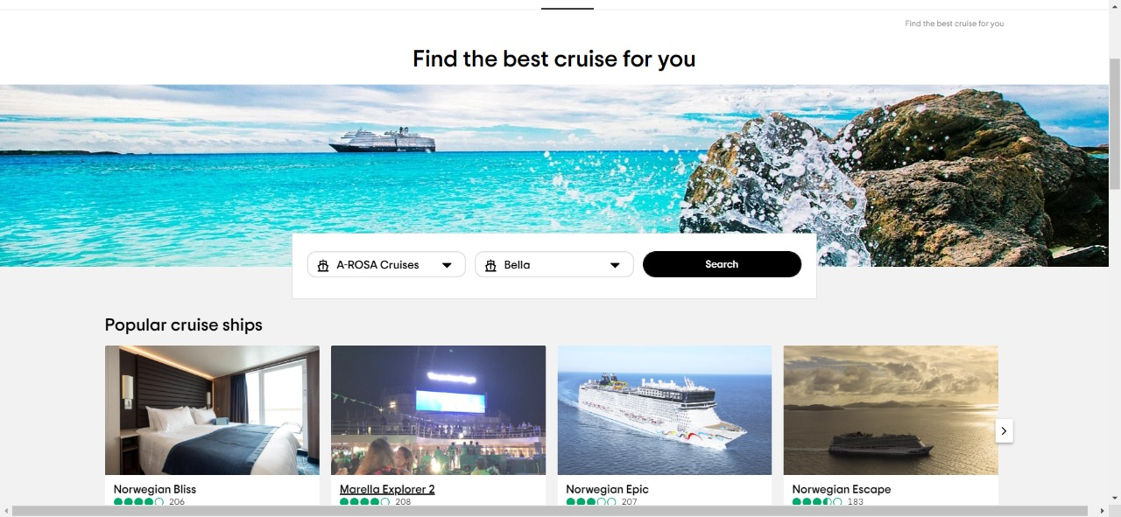
Real Time Screenshot
Cruise Homepage

Slide 14
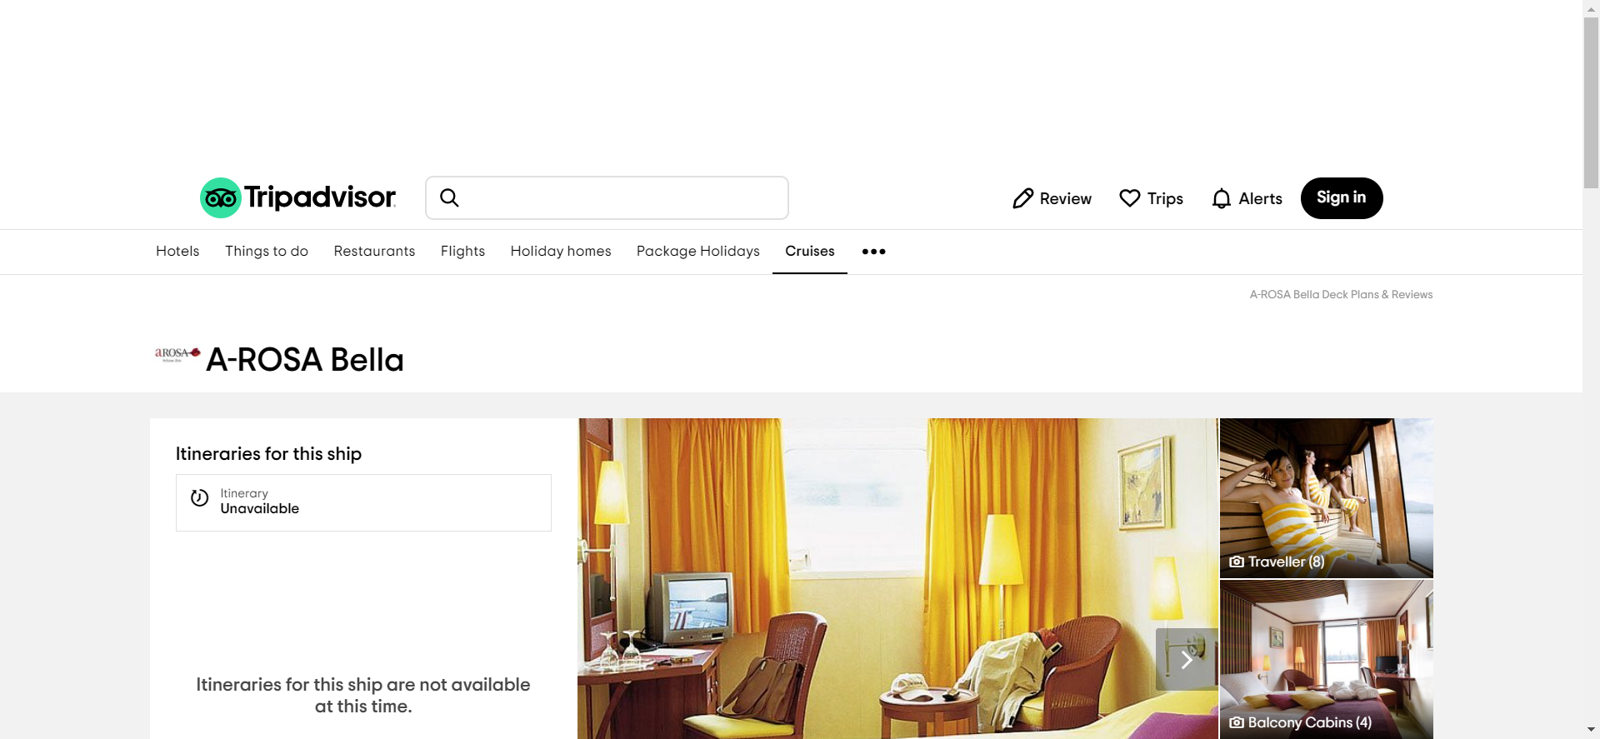
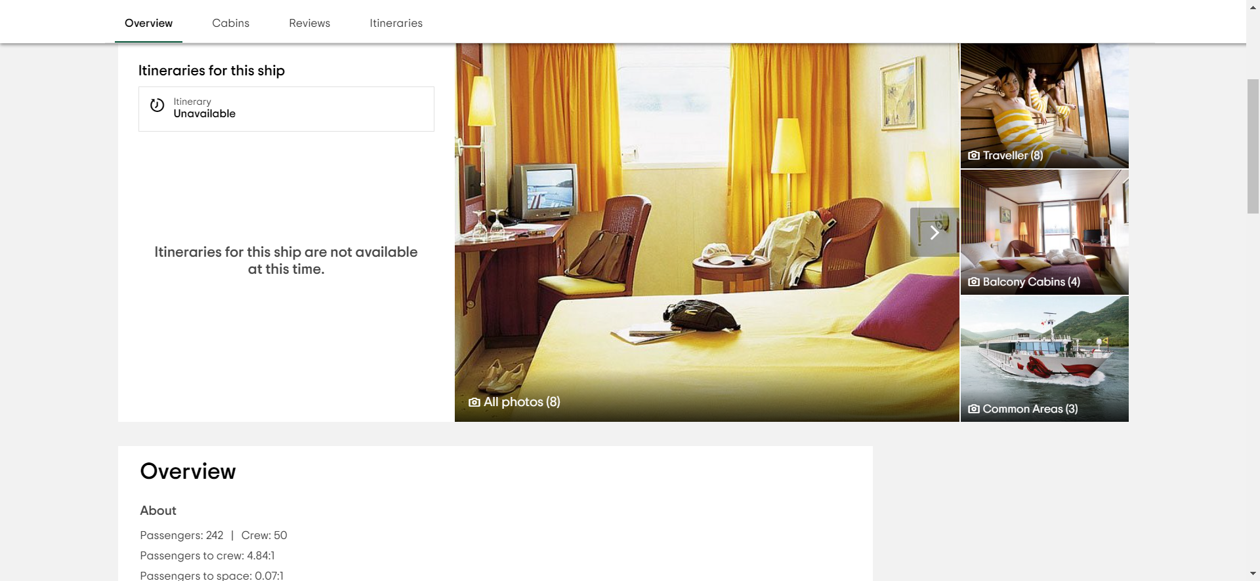
Real Time Screenshot
Cruise Details

Slide 15
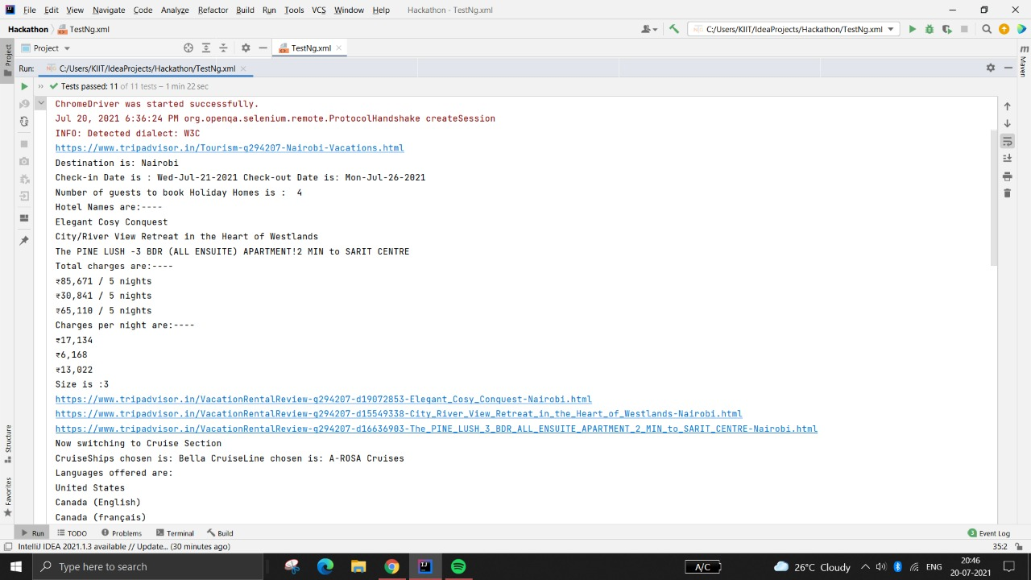
Saved Output Screenshot
TESTNG

Slide 16
Saved Output Screenshot
MAVEN

Slide 17
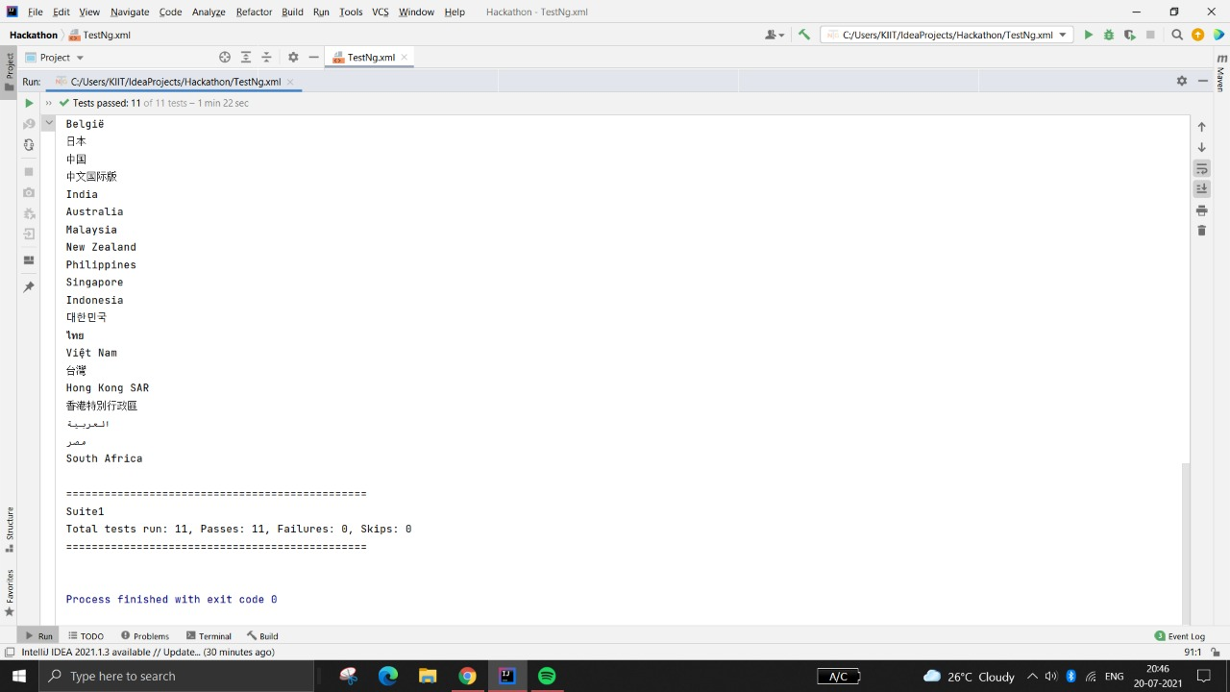
Saved Output Screenshot

Slide 18
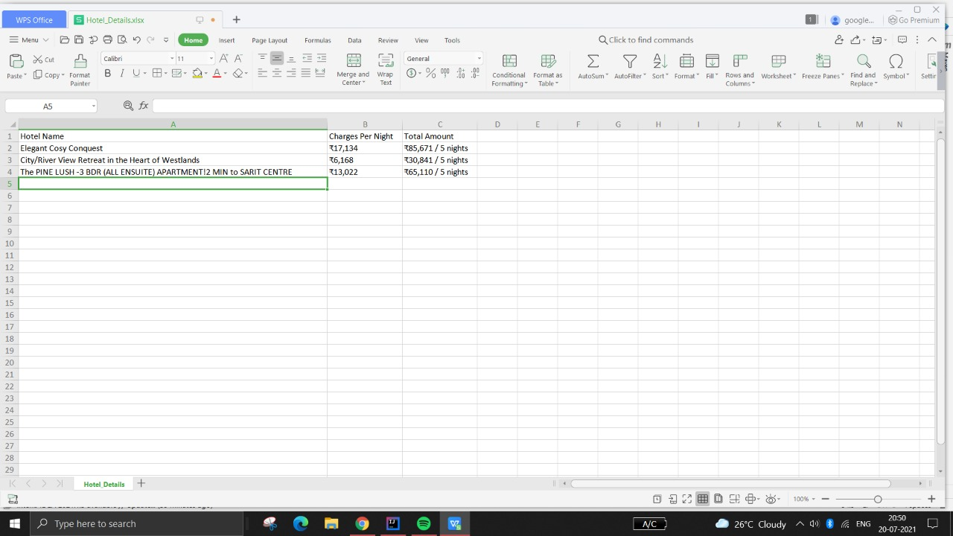
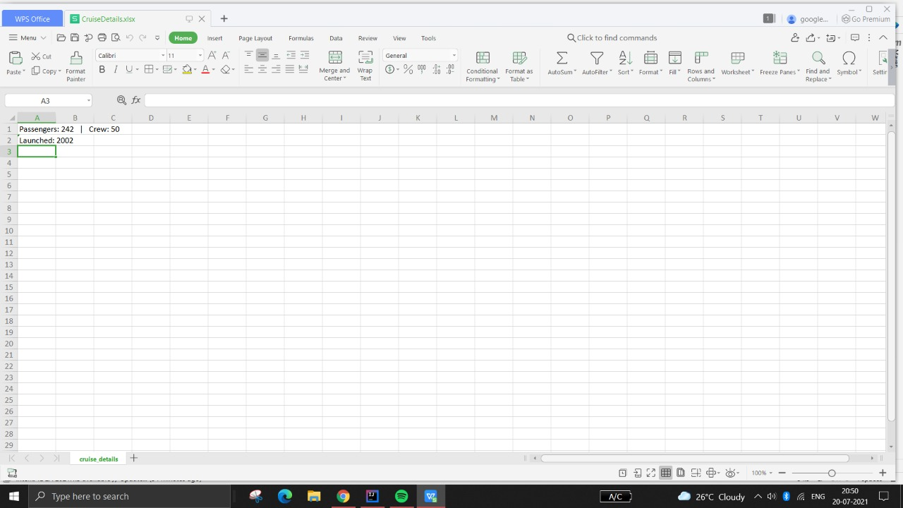
Saved Output Screenshot
Excel Files

Slide 19
THANK YOU

